Slide 1
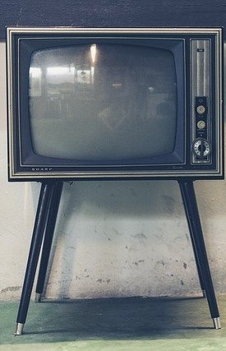
LECTURE EIGHT: SATELLITE COMMUNICATION FOR TELEVISION
ET 8105 – Television Systems

Slide 2
Introduction
TV broadcast requires transmitting antennas at the transmitter and receiving antennas at the receiver.
In TV broadcast, the receiving antenna is different from the transmitting antenna because of the different requirements in respect to power handling and directivity.
A TV transmitter uses a turnstile antenna, consisting of two half-wave dipoles at right angles to each other.
It gives a nearly circular pattern in the horizontal plane
Another type of antenna which is also used at the transmitter, consists of four panels of dipole arrays. The panels are mounted on the four sides.

Slide 3
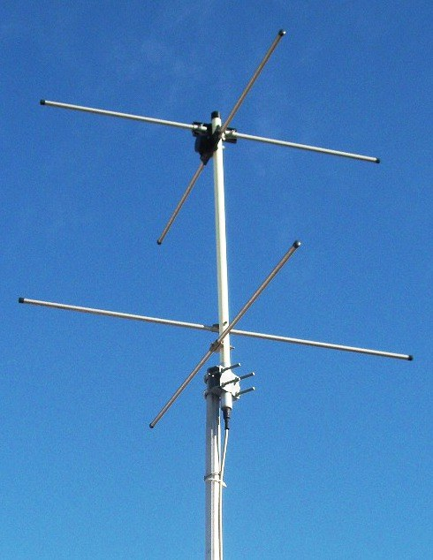
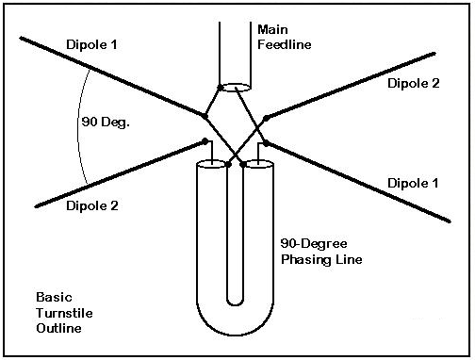
A Turnstile Antenna
two-bay axial mode turnstile antenna

Slide 4
For receiving, the most widely used antenna is Yagi-Uda antenna
It consists of one active dipole or folded dipole, one reflector, about 10% longer than the active element and at least one director bout 10% shorter than the active element.
More directors may be added in fringe areas
A log periodic antenna is used when wide bandwidth is needed
Radio waves from the transmitting antenna use space wave or line of sight propagation because ionosphere is transparent to them and ground attenuates them very fast.
Thus the communication range of TV signals is limited to the radio horizon
This range can be extended by using high towers, or towers mounted on hill tops, or microwave radio relay links, or using satellites.

Slide 5
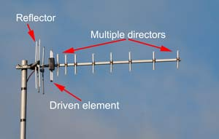
Yagi-Uda antenna

Slide 6
Need of Satellite for Communication
Terrestrial broadcast of television programmes required VHF and UHF bands.
However, these bands could not use the ionosphere, and their propagation was based on line of sight, which limited the range to about 100 km with high towers for antennas.
For long distance communication, there should be a system which could be launched out in space to stay at high altitudes of several thousand kilometres.
A body cannot remain stationary above the earth as it would fall down due to the gravitational pull.

Slide 7
Hence it could only be a revolving body which could balance the gravitational pull (centripetal force) by an equal and opposite centrifugal force.
A body revolving around the earth is called a satellite and thus arose its need for communication.
For television, a satellite should be geostationary, which means the satellite should appear stationary from an earth station, so that the antenna of the earth station may not need any steering.

Slide 8
Geostationary Orbit and Other Orbits
The orbit in which a satellite appears stationary to an earth station is called geostationary orbit.
The essential requirements for an orbit to be geostationary are as mentioned below:
Angular velocity equal to that of the earth (i.e. it should be geosynchronous)
The orbit should have zero degree inclination with the equatorial plane. Any other inclination will not make the satellite stationary for some latitudes, even though it might be geosynchronous.
For zero degree inclination, the orbit must be in the earth’s equatorial plane.

Slide 9
The satellite should travel eastward.
As the earth’s angular velocity is constant, the orbit has to be circular.
The above criteria can be fulfilled by one orbit only.
Hence there is only one geostationary orbit, this is occupied by a large number of satellites.
It is the most widely used orbit at present, and is called Clark Orbit.

Slide 10
Advantages of Geostationary Satellite
Satellite communication has several advantages as compared to terrestrial systems.
These advantages are listed below.
No tracking is required, the satellite remains stationary with respect to the earth
No Doppler effect as the relative velocity between the satellite and the earth is zero
A satellite located at a high altitude from the earth’s surface (about 36 000 km), can provide wide area coverage on earth
A single satellite can cover the whole of a big country or even a continent.
Three satellites with provision of interconnection can provide global communication

Slide 11
The satellite communication is distance insensitive. In land line relay systems, cost increases with distance as microwave towers have to be installed every 50 km or so.
Terrestrial relays are not economical when communication is to be provided to thinly populated areas and difficult terrain. There is no such problem with the satellite
In case of natural or man made calamities, communication can be established by installing an earth station at the concerned place.
Thus emergency communication can be made available within a few hours or at the most a day or two.
Satellite communication is not prone to sabotage as there are no cables running through long distances

Slide 12
Disadvantages of Geostationary Satellite
Distance of the satellite being 36,000 km from the earth’s surface, the microwave power received at the earth station is very low (in picowatts)
To get suitable carrier to noise ratio for good performance of the system, special design techniques have to be adopted which make the system costly
Launching of a satellite is a very costly affair
Solar eclipse for the satellite (when the earth comes in between the sun and the satellite), causes battery drain which, in turn, can cause break in transmission.

Slide 13
Turning on and off of the battery may cause transient noise.
When the sun passes through the beam angle of receiving antenna, the noise increases
However, the single advantage of the satellite looking stationary to the earth station outweighs all other disadvantages which are capable of being managed by proper design, monitoring and control.
Due to this, the geostationary satellites are being used all over the world for TV and other communication needs

Slide 14
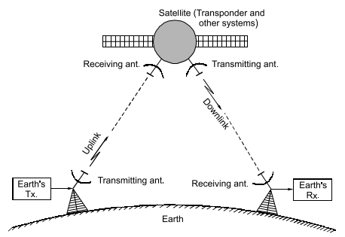
Elements of Satellite Communication
A satellite is primarily a relaying system which receives TV programmes, telephone voice and data at microwave frequency from earth stations and relays them at another microwave frequency to the receiving stations on the earth as illustrated in this figure.

Slide 15
The main role of a communication satellite is to provide reliable communication over large areas.
All other subsystems exist to support the communication.
The communication system is so designed that maximum signal to noise ratio should become available at the receiver of the earth station in the downlink with minimum weight on the satellite and that the system should work for 12-15 years with optimum output without degradation.
The various subsystems involved in satellite communication are described hereafter.

Slide 16
Transponder - the main electronic system which receives microwave power at the uplink frequency, converts it to the lower downlink frequency, amplifies it and sends to the earth through downlink antennas.
Space Craft Antennas - There are two antennas on the space craft, one for receiving signals from the earth’s transmitter and the other for sending signals from the transponder to the earth’s receiver.
Both antennas have to be highly directive to concentrate energy in the desired direction.
Another requirement of antennas of the space craft is that their weight and dimensions should be as small as possible

Slide 17
Power Supply System for Satellite – Solar energy is used as the main source of power.
Photocells convert solar energy into electrical energy which is used to charge storage battery
Batteries charged initially at the earth give power to the subsystems during launch.
Once in the normal orbit, the solar cells charge the batteries and therefore even during eclipse, when the sun is not visible to the satellite, electric power remains available to it

Slide 18
Frequency Bands
The design of satellite links starts with selecting frequencies suitable for uplink and downlink.
The present day communication satellites use microwave bands because of the following advantages:
Microwave antennas can have very high directivity
External noises from atmosphere, etc. are insignificant above 2 GHz
Microwaves provide wide bandwidth to accommodate large number of sidebands of FM and can have large number of channels
The next table show the frequency ranges of the designated bands in the microwave spectrum.

Slide 19
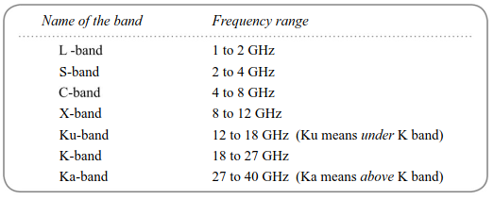
Bands of microwave spectrum

Slide 20
Satellite Relay Systems for Television
Although there are innumerable applications of satellite communication, we are here concerned with its applications for relaying television programmes.
Television through satellites consists of the following three systems:
Broadcasting of TV programmes to long distances, using satellites to relay programmes to the terrestrial transmitters for further transmission within line of sight communication range. This type of service is called long distance satellite broadcast service for terrestrial networks.

Slide 21
Satellites for relaying TV programmes to cable operators who receive the programmes at their head ends and after amplifying and processing, they send these to the subscribers’ homes through cables (CATV system). This system is called TVRO, i.e. TV Receive Only.
Satellites for relaying TV programmes direct to individual homes. This system is called Direct-To-Home (DTH) system.

Slide 22
Long Distance Satellite Broadcast Service for Terrestrial Networks
This service uses C-band frequencies with antenna dish at the earth’s transmitting station and also at the earth’s receiving station.
Even low power at the transponder can give good signal strength at the earth’s receiving station.
The receiving station demodulates the input signal and sends it to the terrestrial transmitter for further transmission.
Its block diagram is shown in the next figure

Slide 23
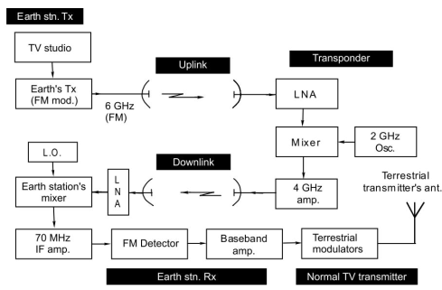
Block diagram showing TV broadcast satellite system

Slide 24
Direct-to-Home TV (DTH) Satellite
DTH is defined as the reception of satellite programmes with a personal dish in an individual home.
Here the transponder has to produce high power of about 100 W.
Hence the transponder uses double conversion of the signal.
The input signal is first down-converted to an intermediate frequency of 70 MHz.
Much higher gain of the signal can be achieved at 70 MHz than at microwave frequency.
The amplified output of the IF amplifier is now up-converted to the downlink frequency of about 11 GHz

Slide 25
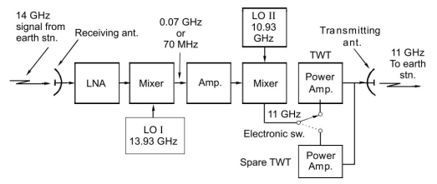
Transponder for DTH

Slide 26
The DTH receiver is like any other receiver, except that the frequency being in Ku band or K band, the size of the dish antenna is quite small.
For Ku band, it is about 60 cm and for K band it is much smaller.
Another distinguishing feature is that the stages handling microwave frequencies are located outside the home at the antenna itself and are called outdoor units.
The outdoor unit consists of a receiving antenna, low noise amplifier and converter
LNA cannot be kept indoor because long cable between the horn and the first LNA will cause substantial degradation of the overall noise figure of the set
In case of pay TV, a set-top-box (STB) is needed to descramble the desired channels by the authorized consumers.

Slide 27
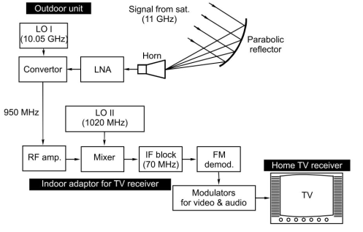
Block diagram of DTH receiver

